Slide 1
Ag & Solar Energy
Lesson 5

Slide 2
What is Photovoltaics?
https://youtu.be/manp7iEyxCI

Slide 3
What is Photovoltaics?
When sunlight enters the semiconductor material (typically silicone) it “frees” electrons that can be gathered into a DC current with thin wires placed on the crystals.

Slide 4
Photovoltaics
Benefits
Concerns
Reliable, low-maintenance energy production
Reduces energy bills and provides profit potential
Unlimited and clean domestic fuel source
Remote onsite power production
Independence from fluctuating fuel prices
Increases overall food security for the U.S.
Self-sufficient
Solar cell manufacturing is an energy-intensive process that produces GHG and contaminants such as heavy metals.
PV panels pose environmental risks if not recycled properly after their useful life of ~25 yrs.

Slide 5
On farm uses of solar power
Lighting: For remote lighting, batteries are charged during the day to run efficient LED light bulbs.
Water pumps: Although the flow rate can be less than one gallon per minute, a DC solar well pump can still provide over 350 gal. of water per day.
Irrigation: Specialized pivot irrigation systems can be powered by deep cycle batteries charged by solar panels, 24v control circuitry, and 90v DC motors.
Solar drip irrigation is extremely efficient at delivering water

Slide 6
On farm uses of solar power
Electrical fences: A single solar panel can run an electric fence with no moving parts to break or wear out. An attached battery will allow it to go days without recharging.
Remote electrical needs: remote electricity supply is often cheaper than having the utility company build new power lines to these locations.
Creative uses: solar powered “scarecrow” uses specific acoustic ranges to deter birds from fields.
General farm electrical needs

Slide 7
Affordable options
Can significantly reduce on-farm electric costs and provide free power once system is paid for.
PV cost is currently at a record low of $2/Watt.
Qualifies for generous rebates and tax credits.
Can generate income with net-metering.

Slide 8
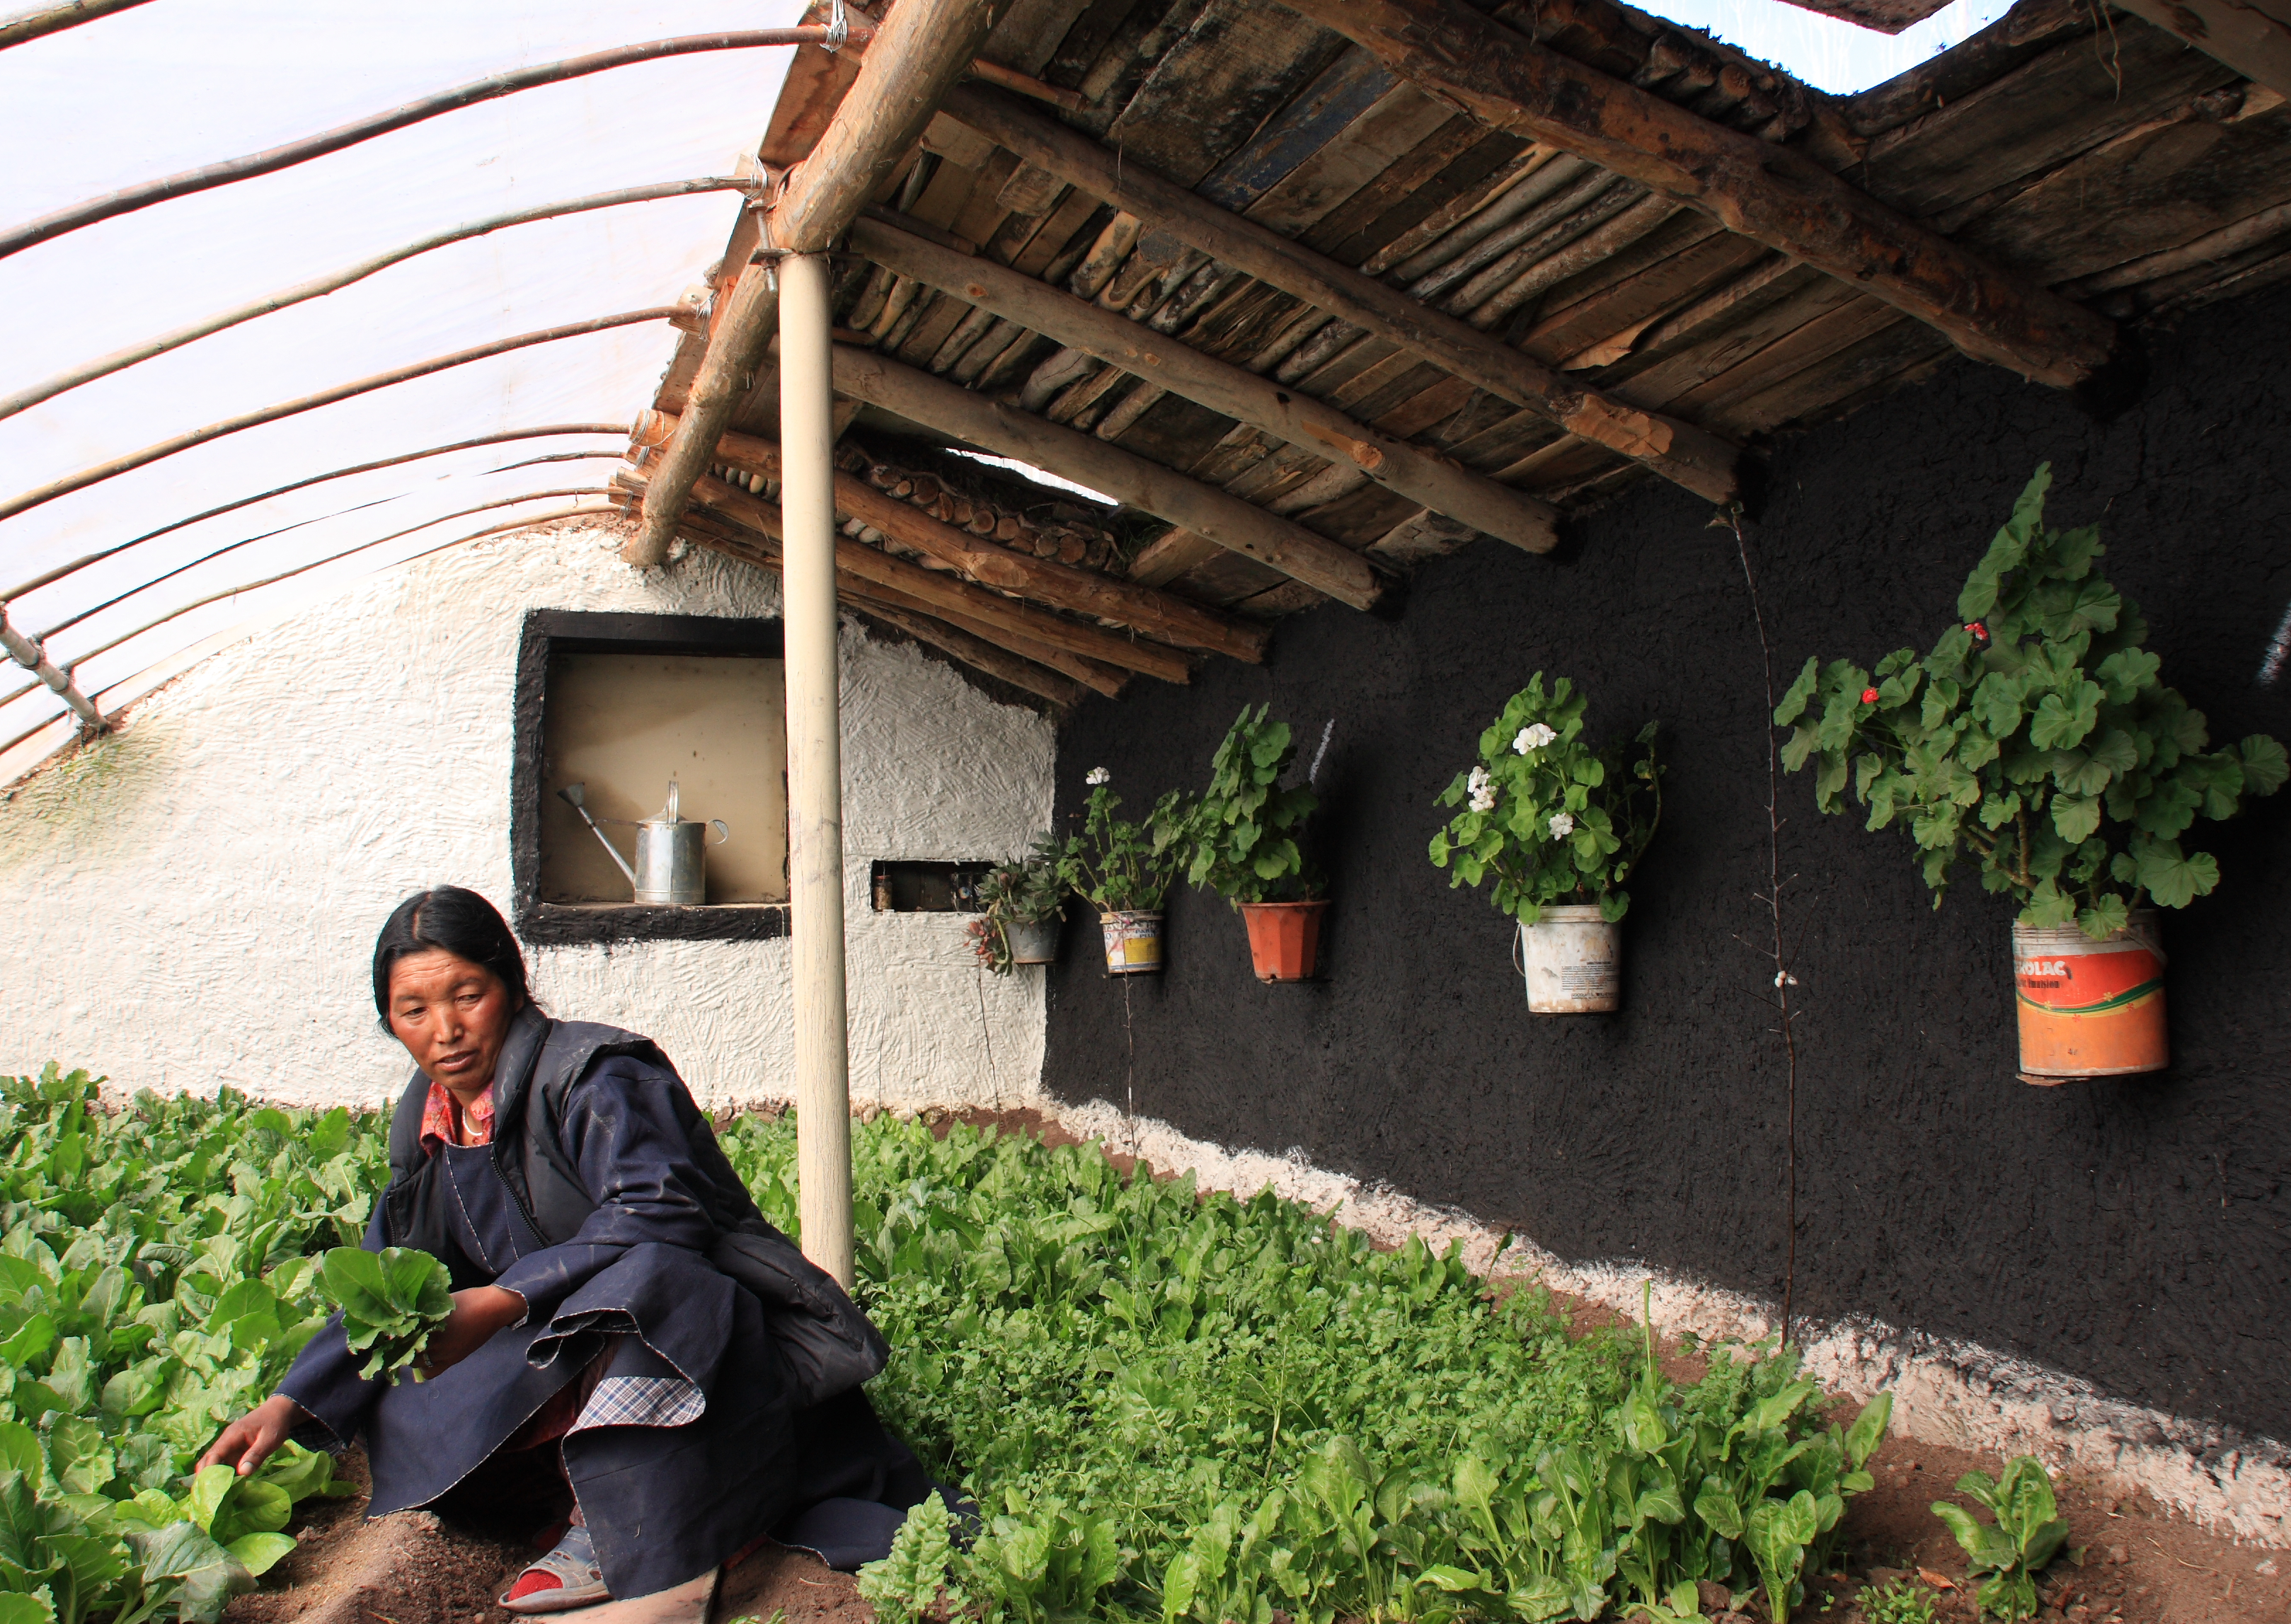
On farm uses of thermal solar energy
Space heating: Preheat incoming fresh air for farm buildings.
Radiant solar: Glazed flat-plate solar collector for heating buildings
A black absorber plate, oriented toward the sun, warms the fluid passing through the flow tubes.

Slide 9
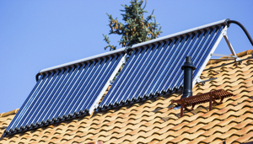
On farm uses of thermal solar energy
Water heating: Provide hot water for cleaning, dairy needs, etc.
Fluid is circulated through glass tubes within panels and warmed to ~160°F.
A heat exchanger pulls the radiant heat from the fluid to warm forced air or water.
A thermosiphon solar water heater does not need an electric pump as gravity and thermal convection (hot water rises, while cool water sinks) operate together in the system.

Slide 10
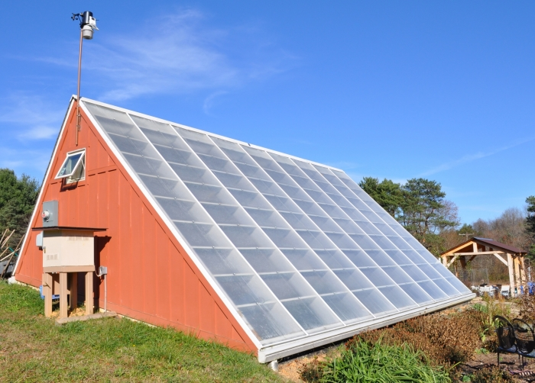
On farm uses of thermal solar energy
Greenhouse heating: Passive solar designs for greenhouses.
Water/glycol is warmed by solar thermal panels and circulated through pipes in soil.
Heated soil extends the growing season by maintaining nutrients and increasing germination rates.
Passive solar heating and cooling takes advantage of natural energy characteristics in materials and building designs with exposure to the sun.

Slide 11
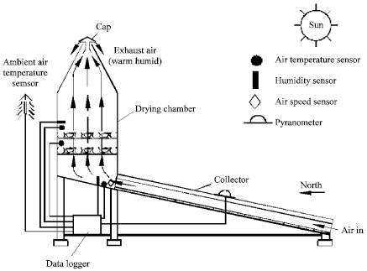
On farm uses of thermal solar energy
Crop and grain drying: Solar thermal convection/air heating.
While slower than gas-fired driers, solar thermal grain dryers are extremely efficient and can pay for themselves in just a few years.

Slide 12
U.S. Solar Potential
https://maps.nrel.gov/re-atlas/

Slide 13
U.S. Solar Potential
All energy stored in the earth’s reserves of coal, oil, and natural gas is equal to the energy in just 20 days of SUNSHINE!
Producing electricity from solar cells reduces overall air pollutants and greenhouse gasses by approximately 90%, compared to using conventional fossil fuel technologies.
How will farmers finance the installation of these? Will they be worth the investment?

Slide 14
Review
1. An example of passive thermal solar energy would be:
Water heating
Space heating
Grain drying
Remote electricity needs

Slide 15
Review
2. Photovoltaics creates what kind of electrical current?
DC (direct current)
AC (alternating current)
EC (electron current)
BC (bi-directional current)

Slide 16
Review
3. What benefits do photovoltaics offer?
Low maintenance energy production
Remote onsite power production
Reduction in energy bills
All of the above

Slide 17
Review
4. Which is not an example of on farm photovoltaic solar power use?
Water pumps
Irrigation
Radiant greenhouse heat
Electrical fences

Slide 18
Review
5. A thermal solar water heater does not need a pump and works on gravity and thermal convection because
A heat exchanger pulls the heat from the fluid
Hot water rises, cool water sinks
The panels tilt to let water flow down
Glass tubes keep the water viscous and flowing

Slide 19
Review
6. Water/glycol warmed by solar thermal panels and circulated through pipes in the soil provide what benefit?
Provide maximum exposure to the sun
Help water the plants
Help loosen the soil
Heat the soil extending the growing season

Slide 20
Review
7. Which grain drying system, while slower, is most energy efficient?
Propane gas fired drier
Motor auger grain dryer
Thermal grain dryer
Natural air low temperature drying

Slide 21
Review
8. Producing electricity from solar cells reduces air pollutants by approximately _____ compared to using fossil fuels.
90%
80%
70%
60%

Slide 22
Review
9. What semiconductor is typically used to construct photovoltaic cells?
Arsenic
Selenium
Silicon
Tellurium

